Slide 1
DevSecOps Hackathon

Slide 2
Story
Customer Problem Statement
Show Architecture
Show demo on digital transformation
Show numbers -> developer velocity (3x) , productivity, deployment frequency (25x)
How they achieved:
Leveraging practices

Slide 3
Companies are struggling with
58%
62%
Dev & Security Silos
Of security and development teams do not collaborate
Shift left
Of enterprises do not integrate security in the development phase
60x
218
days
Security cost
to fix a security defect in production than in development
Remediation time
Average time it takes to detect a vulnerability
Sources: McKinsey Developer Velocity, Microsoft Enterprise DevOps Report, GitHub Octoverse Report 2020
Notes:
However, digital leaders are still facing challenges with security and development.
Even now, 58% of security and development teams do not collaborate. Security has gotten pushed to the end of application development and management. In fact, 62% of enterprises do not integrate security in the development phase at all. Unfortunately, 75 percent of bugs are not found until production which comes with big costs. It can cost 60 times more to fix a security defect in production than in development. This bottleneck is one reason organizations typically take 218 days to uncover a security vulnerability, which can also be extremely costly.
What’s next for digital leaders trying to handle the security and compliancy of the code, workflows, and infrastructure?
Synopsys

Slide 4
Challenges

Slide 5

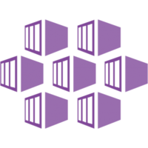



Slide 6
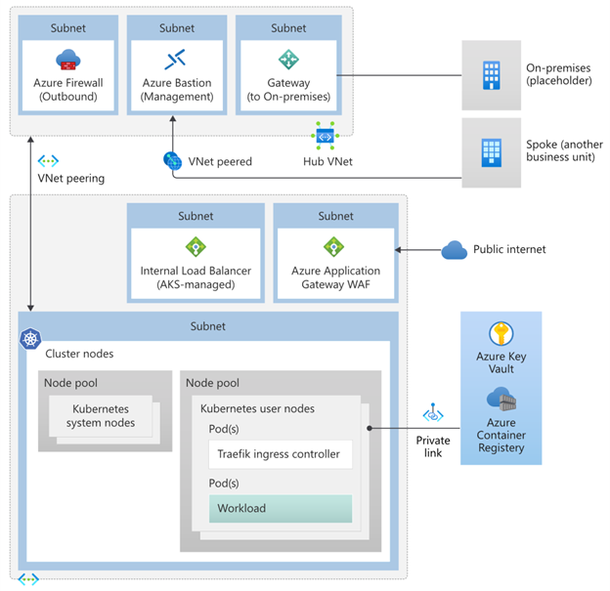

Slide 8
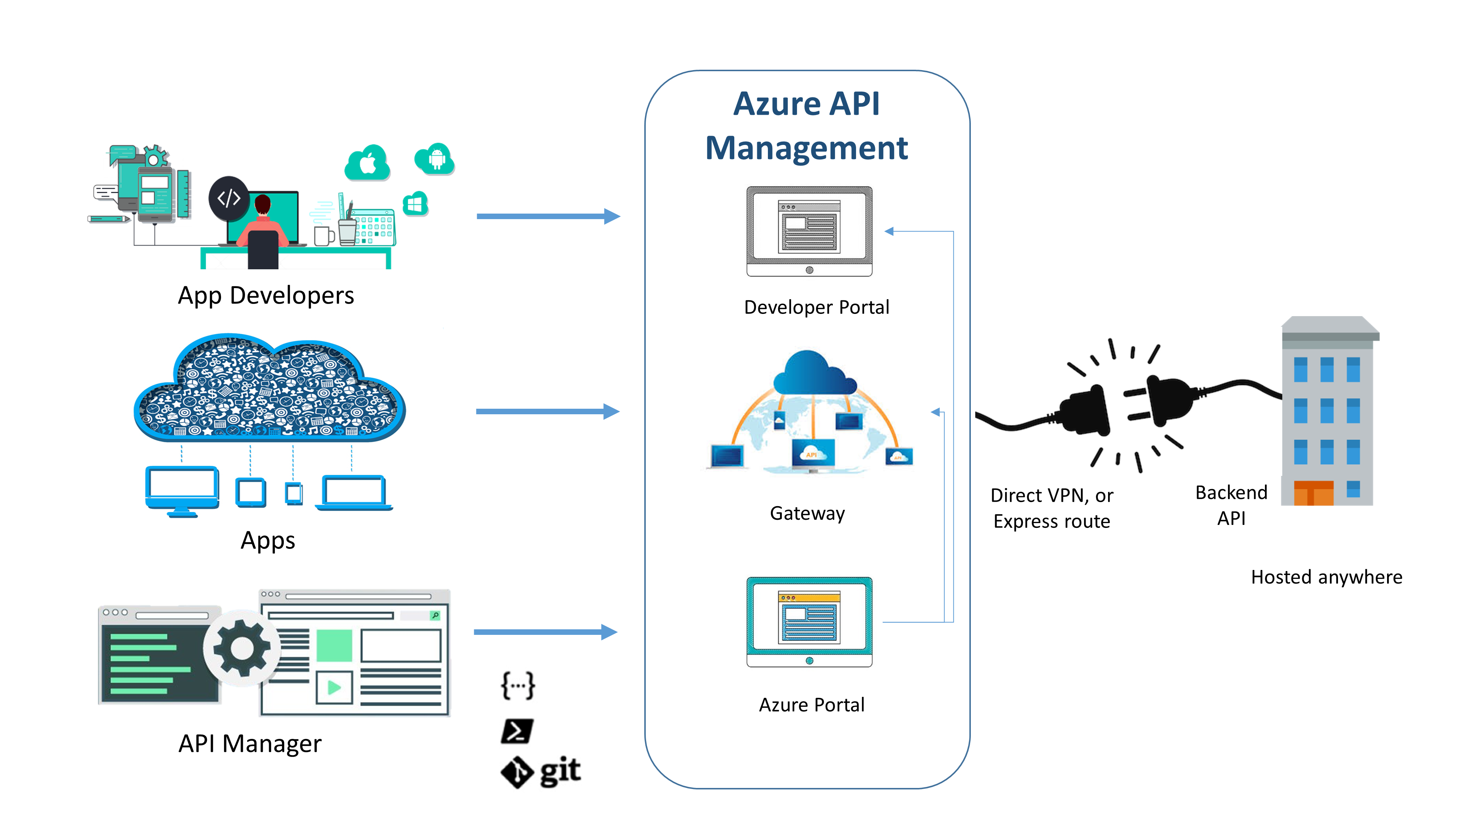

Slide 9


A unified solution from Microsoft helps scale DevSecOps practices
GitHub
Azure
Dependabot
CodeQL
Secret scanning
GitHub Actions
Azure Security Center
Azure Monitor
Azure Policy
Azure Key Vault
Shared tooling
Notes:
Between GitHub and Azure, we have a suite of tools and services to help. One thing we'll find is that as teams build shared responsibility, there tends to be a set of shared tooling as well - whether it's the same toolset or integrations between tools. We'll dive deeper into some of these.
From shifting left with GitHub, to understanding runtime behavior of your apps and infrastructure with Azure Monitor, to policy as code with Azure Policy, to secret management with Azure Key Vault, to Azure Security Center, your home for security information and status - Azure and GitHub provide the building blocks to develop and scale DevSecOps practices.

Slide 10
Modernizing DevSecOps Strategy
Automate Secure Infrastructure Deployments to Azure
Automate Secure Application Deployments to Azure
Monitor Deployments for Security in Azure

Slide 11
Modernizing DevSecOps Execution – How did we do it?
Automated Secure Infrastructure Deployments to Azure
Used AKS Deploy Helper to define Construction Set
Used GitHub Actions to Deploy AKS Construction Set
Automate Secure Application Deployments to Azure
Used GitHub Actions to build and push container images to Secure ACR
Used GitHub Actions to secure deploy application
Used GitHub Security for secure CI/CD Workflows & Branches
Monitor Deployments for Security in Azure
Security Center
Azure Defender
Monitor

Slide 12
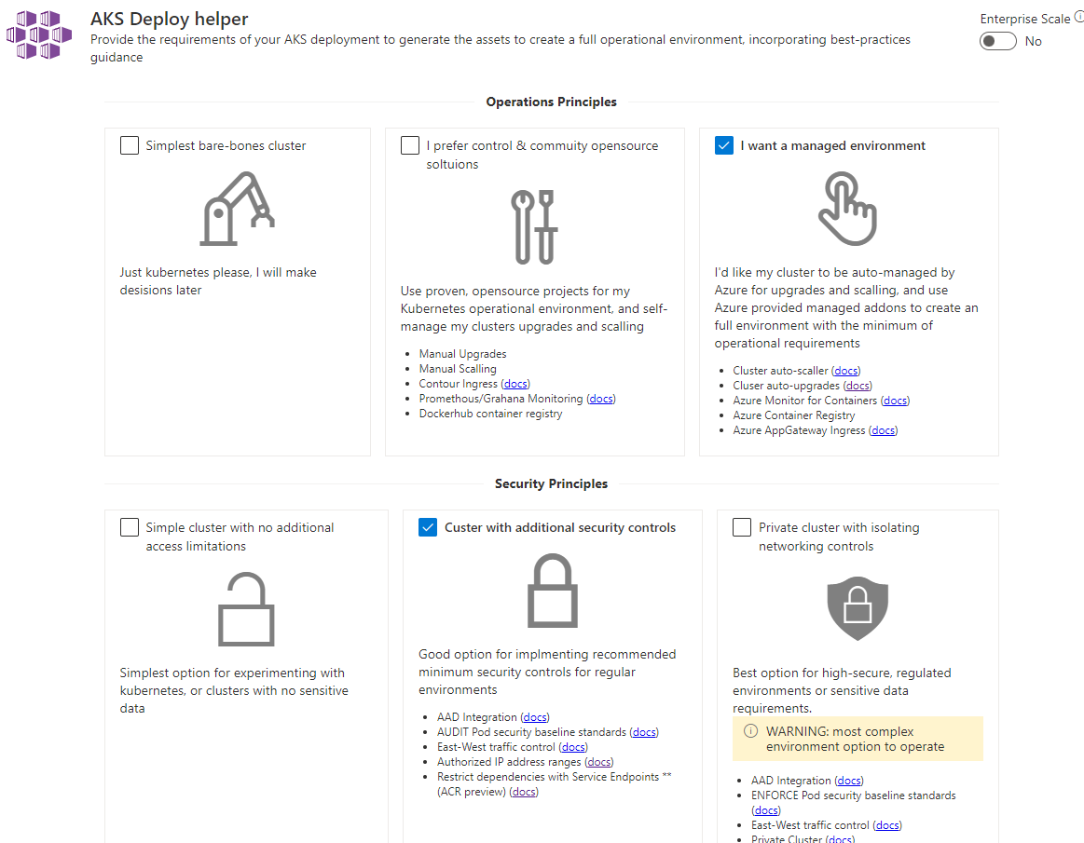
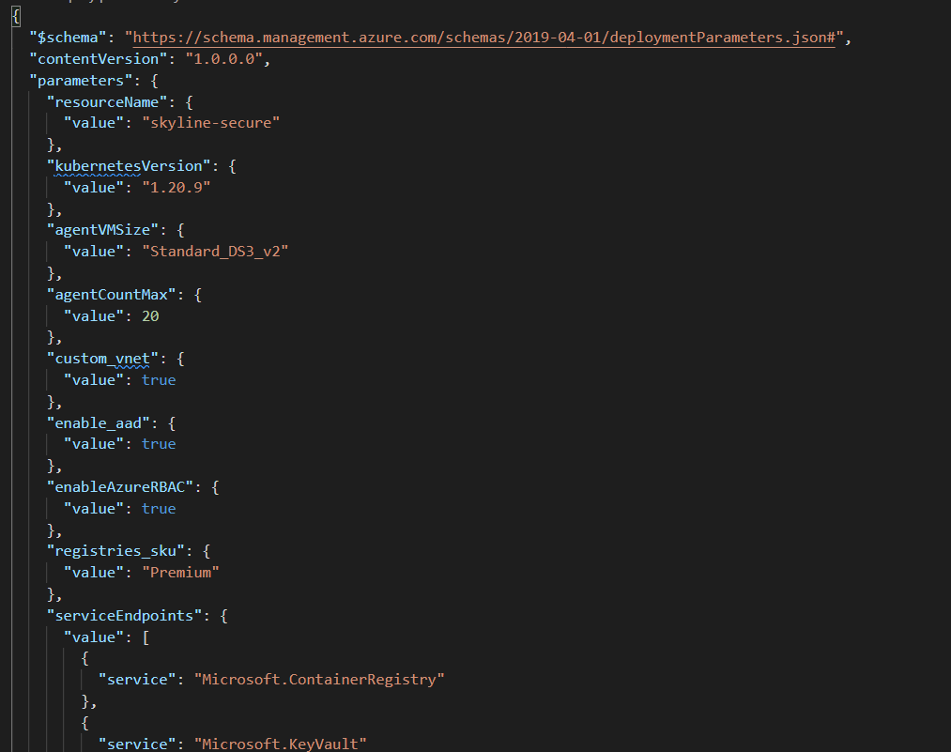
Used AKS Deploy Helper to define Construction Set
AKS Deploy helper (azure.github.io)

Slide 13
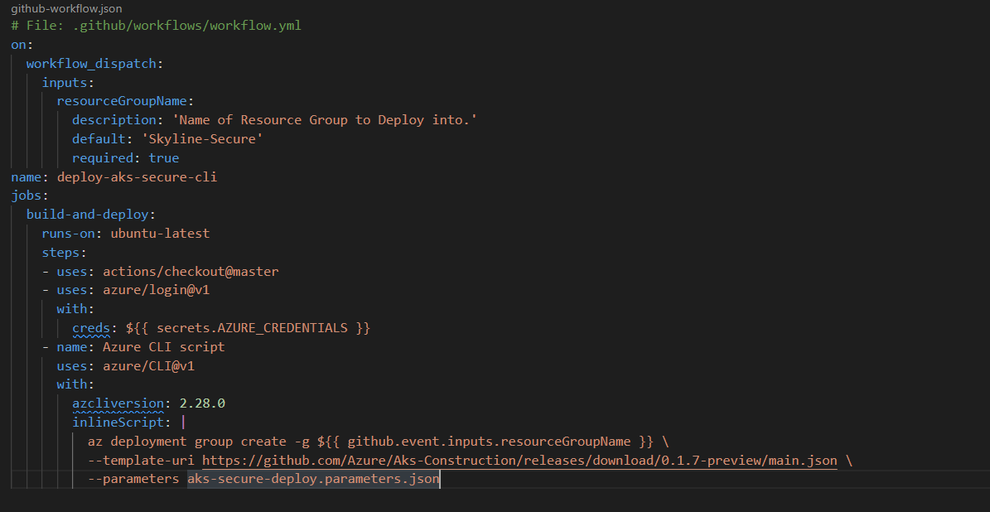
Used GitHub Actions to Deploy AKS Construction Set

Slide 14
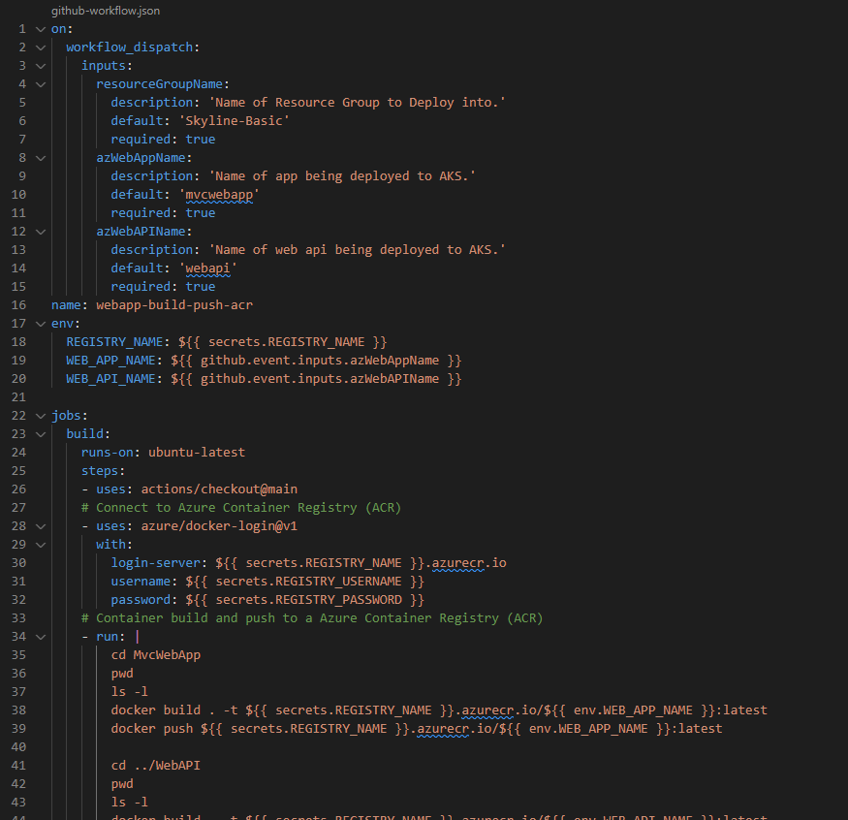
Used GitHub Actions to build and push container images to ACR

Slide 15
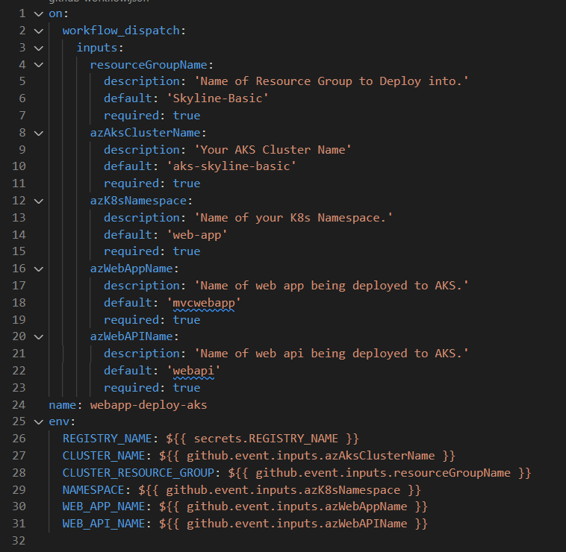
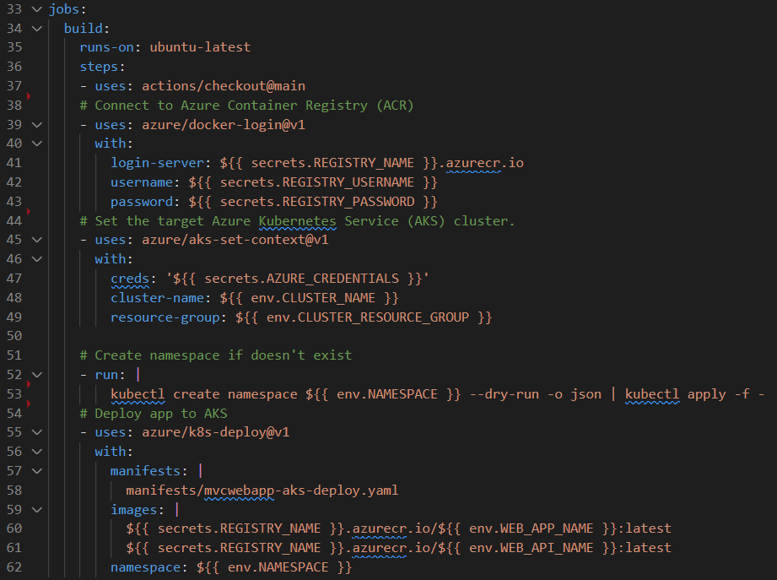
Used GitHub Actions to deploy application

Slide 16
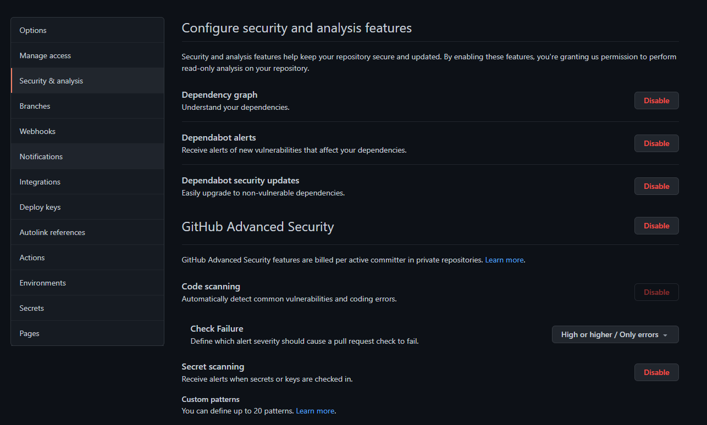
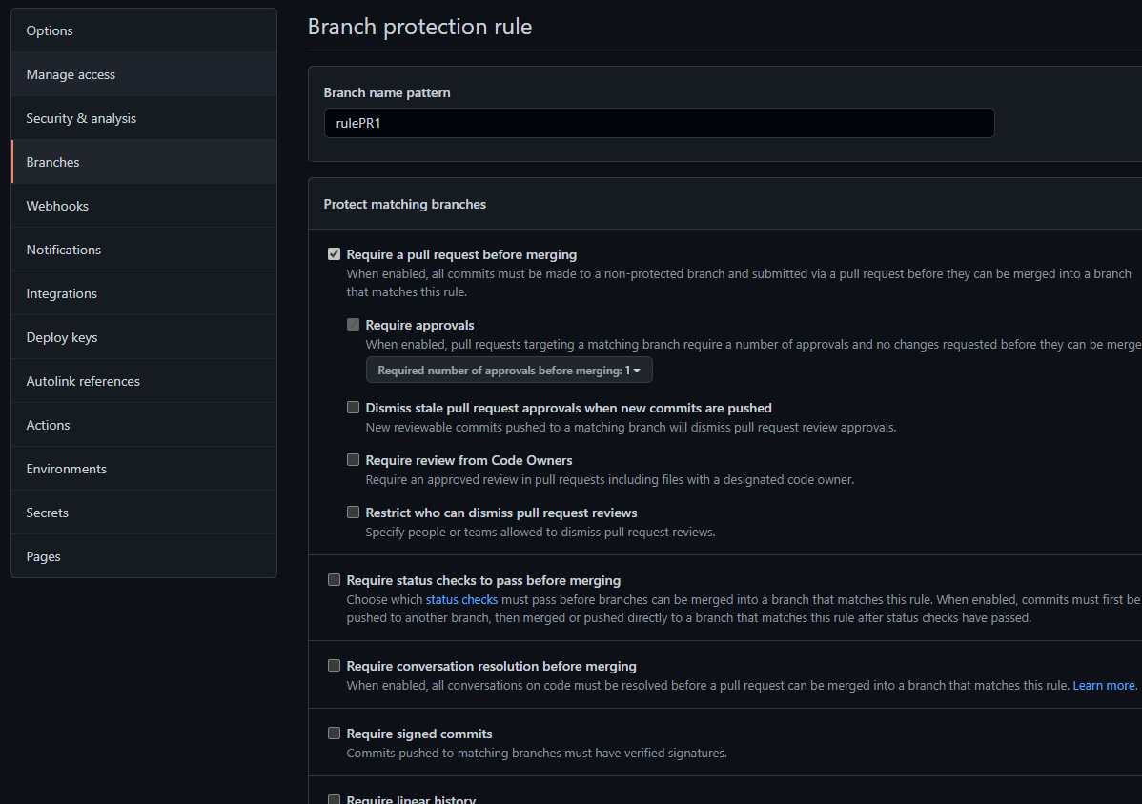
Used GitHub Security for secure CI/CD Workflows & Branches

